Slide 1
Processing OWL2 ontologies using Thea: An application of logic programming
Vangelis Vassiliadis¹
Jan Wielemaker²
Chris Mungall³
¹ semanticweb.gr
² VU University Amsterdam
³ Lawrence Berkeley National Laboratory

Slide 2
Contents - Outline
Why – Motivation
Context: Semantic Web → Applications → Tools
OWL Tool survey – What we do with them
Model, I/O (Parser / Serialisation), Query, Manipulate, Reasoning (Inference)
What – can we do with Thea
Use of Prolog as an application programming language (host language), rather than as an OWL reasoning engine
Get OWL ontologies (ABOX + TBOx) in a prolog program.
Use them: Query – Reason
Script operations
Build applications
How – Implementation
Application examples - potential
Notes:
Why should I use it.

Slide 3
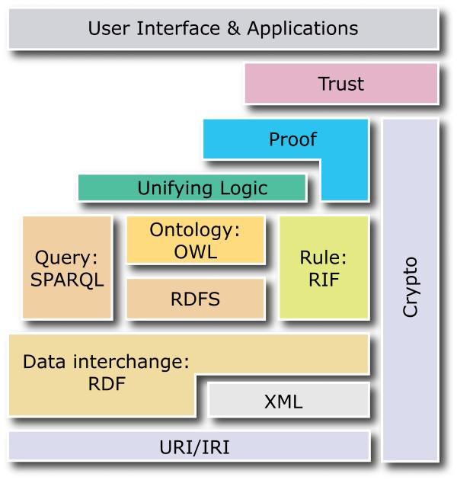
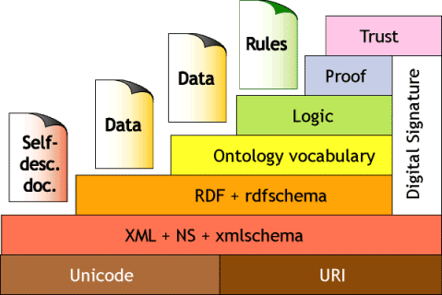
Motivation
Original 2000 stack
2008 stack
Notes:
SW – cake, RDF – OWL – tools.
Evolution from 2000 to 2008.
Added layer of User Interface and Applications
Specs now for up to Ontologies and Rules
Need applications – need tools (to build applications and realise UI)
Ontology Engineering: Protégé et al.
Reasoning servers: KAON, Petllet
APIs: Jena, OWLAPI..
Others: Allegro
RDF centric tools ‘triple-focus’ not suitable for complex T-Boxes heavily axiomatized.
BUT… need for Easy programmatic access to Ontologies or Knowledge bases.
Querying
Scripting operations
Build applications
History – versions etc

Slide 4
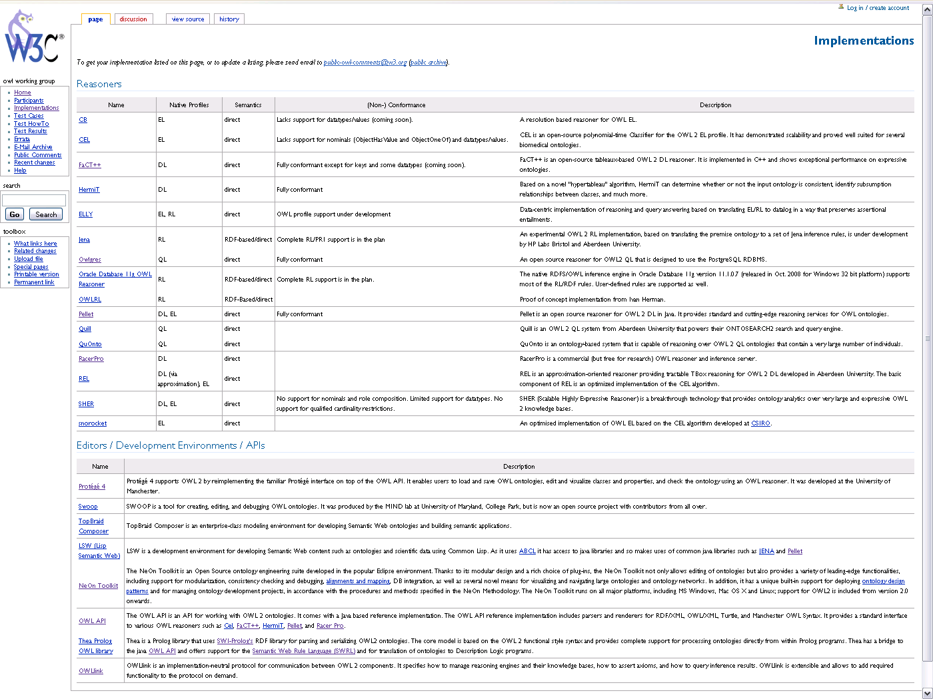
OWL Tools

Slide 5
Tool functionality
Model - Store
Parse – Serialize
(Input - Output)
Query
Manipulate
Reason (Inference)
Notes:
http://www.mkbergman.com/862/the-sweet-compendium-of-ontology-building-tools/

Slide 6
Why Prolog?
Fact database (Store)
Thea uses Prolog as a host programming language, not as a reasoning system, but
Can also be used as a Rule-based system. (Reason)
SLD resolution, backward chaining.
Declarative features, pattern matching (Query)
Scripting language – (Manipulation)
SWI-Prolog implementation, Semweb package,
efficient RDF library (Parse – Serialize) (Load, Save)
Http servers
Own experience

Slide 7
Thea project
Prolog library, organized in modules.
Depends heavily on SWI-prolog libraries
RDF/XML parsing, serializations,
http-client
Development History
Started 2004
Version 0.5.5 (final for OWL1) in 2006 / SourceForge
Major redesign for OWL2 in 2009 (presented in OWLED 2009) / Github
Circa 2000 downloads.
OWL2 axioms as Prolog facts based on the OWL functional syntax.
Extensions / libraries to support:
java OWL API
SWRL
translation to DLP
RL Reasoning (Forward and backward chaining)
OWLLink – act as an OWLLink client.
Small set of applications / demos
Minimum documentation

Slide 8
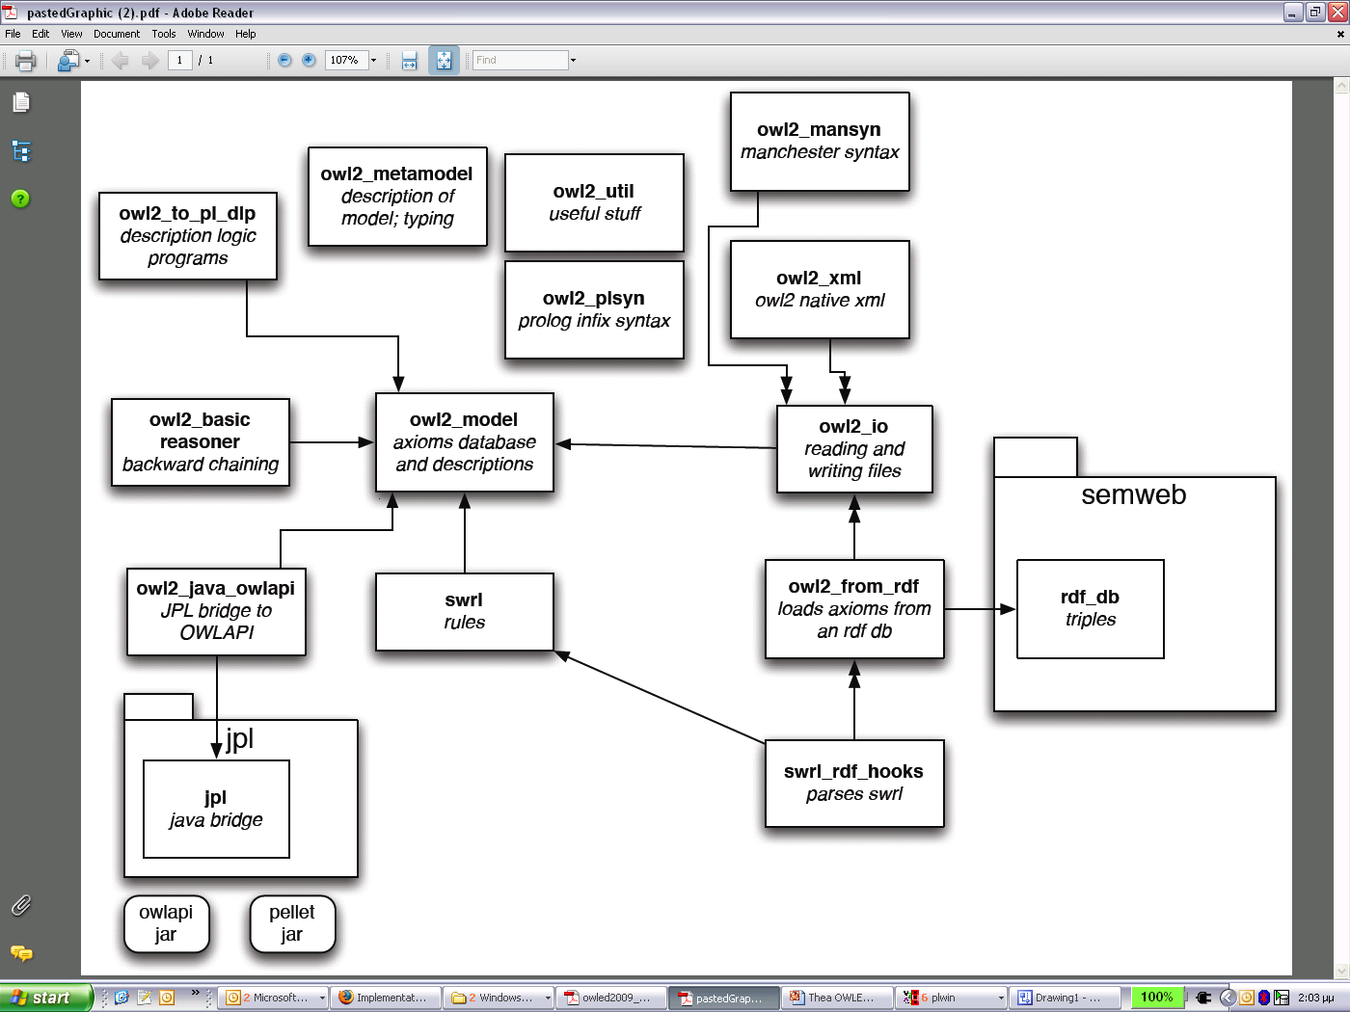
Library organisation

Slide 9
OWL Functional-Style Syntax and Structural Specification
Model - Store
Parse – Serialize (Input Output)
Query
Manipulate
Reason (Inference)
Ontology as a set of Axioms
Axiom := Declaration | ClassAxiom | ObjectPropertyAxiom | DataPropertyAxiom | HasKey | Assertion | AnnotationAxiom
Declaration := 'Declaration' '(' axiomAnnotations Entity ')‘
Entity := 'Class' '(' Class ')' | 'Datatype' '(' Datatype ')' | 'ObjectProperty' '(' ObjectProperty ')' | 'DataProperty' '(' DataProperty ')' | 'AnnotationProperty' '(' AnnotationProperty ')' | 'NamedIndividual' '(' NamedIndividual ')‘
ClassAxiom := SubClassOf | EquivalentClasses | DisjointClasses | DisjointUnion
SubClassOf := 'SubClassOf' '(' axiomAnnotations subClassExpression superClassExpression ')‘
ClassExpression := Class | ObjectIntersectionOf …
ObjectIntersectionOf := 'IntersectionOf' '(' ClassExpression ClassExpression { ClassExpression } ')'
SubClassOf(’http://example.org#Human’ ’http://example.org#Mammal’).
EquivalentClasses(forebrain_neuron
IntersectionOf(neuron
SomeValuesFrom(partOf forebrain)))

Slide 10
Thea model implementation
Model - Store
Parse – Serialize
(Input - Output)
Query
Manipulate
Reason (Inference)
Axioms → Extensional Prolog predicates / facts
subClassOf(’http://example.org#Human’,’http://example.org#Mammal’).
equivalentClasses([forebrain_neuron,
intersectionOf([neuron,
someValuesFrom(partof,forebrain)
])
]).
Expressions defined as Prolog terms
Lists for variable number arguments
More programmatic convenience predicates (Intentional)
axiom(A) :- classAxiom(A).
axiom(A) :- propertyAxiom(A).
…
property(A) :- dataProperty(A).
property(A) :- objectProperty(A).
property(A) :- annotationProperty(A).
ontologyAxiom(Ontology, Axiom) (Extensional)
relates Axioms to specific Ontology
Annotations not as axiom arguments but as separate facts:
annotation(Axiom, AnnotationProperty, AnnotationValue) (Extensional)

Slide 11
Thea OWL Parser - Serializer
Model - Store
Parse – Serialize
(Input - Output)
Query
Manipulate
Reason (Inference)
OWL RDF/XML
RDF graph
OWL2 Model
RDF/XML is Normative
OWL XML
Manchester syntax
SWI Semweb package
RDF library (rdf/3 facts)
Namespace and import handling
File:// and http:// support
RDF graph to Axiom conversion and vice – versa.
Simple Repository implementation
Load – Save Axioms

Slide 12
Thea OWL Parser - Serializer
Model - Store
Parse – Serialize
(Input - Output)
Query
Manipulate
Reason (Inference)
Parse:
owl_parse_rdf(+URI,+Opts:list), owl_parse_xml(File,_Opts), owl_parse_manchester_syntax_file(File,_Opts)
options for imports, clear rdf graph, clear axioms
owl_repository(URI, LocalURI)
Implements owl2_io:load_axioms_hook(File,[owl|mansyn|owlx],Opts)
Serialise:
owl_generate_rdf(+FileName,+RDF_Load_Mode)
Save Axioms as Prolog facts
Load Axioms from Prolog files (consult).
Possible extensions:
Save and Load to/from external ‘OWL-aware’ databases: e.g. OWLgress

Slide 13
Query OWL ontologies
Model - Store
Parse – Serialize
(Input - Output)
Query
Manipulate
Reason (Inference)
Simply use Prolog’s declarative pattern matching and symbol manipulation:
Tbox
:- class(X).
:- subClassOf(X,Y).
:- class(X), equivalentClasses(Set), select(X,Set,Equivalents).
:- propertyDomain(Property,Domain).
:- findall(X, subClassOf(Y,X),Superclasses).
subclass(X,X).
subclass(X,Y) :-
owl2_model:subClassOf(X,Z),subclass(Y,Z). (!cyclic graphs)
Abox
:- classAssertion(C,I).
:- propertyAssertion(P,I,V).
:- findall(I, classAssertion(C,I),Individuals).
:- class(C),aggregate(count,I,classAssertion(C,I),Num).
…

Slide 14
Manipulate OWL ontologies
Model - Store
Parse – Serialize
(Input - Output)
Query
Manipulate
Reason (Inference)
Programmatic processing or scripting of ontologies for tasks that would be tedious and repetitive to do by hand:
Enforce disjointUnion with exceptions
setof(X,(subClassOf(X,Y),
\+ annotationAssertion(status,X,unvetted)),
Xs),
assert_axiom(disjointUnion(Y,Xs))
Populate Abox: generate Axioms from external data:
read(Stream, PVTerm), PVTerm :=.. [C,I|PVs],
assert_axiom(classAssertion(C,I),
forall(member(P-V,PVs), assert_axiom(propertyAssertion(P,I,V)),fail.
Assumes Stream contains terms of the form:
Class(IndividualID, Property1-Value1, …, PropertyN-ValueN).

Slide 15
Reasoning with OWL
Model - Store
Parse – Serialize
(Input - Output)
Query
Manipulate
Reason (Inference)
What is Inference?
Broadly speaking, inference on the Semantic Web can be characterized by discovering new relationships. On the Semantic Web, data is modeled as a set of (named) relationships between resources. “Inference” means that automatic procedures can generate new relationships based on the data and based on some additional information in the form of a vocabulary, e.g., a set of rules. Whether the new relationships are explicitly added to the set of data, or are returned at query time, is an implementation issue.
From (www.w3c.org) SW activity
OWL Reasoning
Consistency checking
Hierarchy classification
Individual classification
OWL (DL) vs. Logic Programming theoretical issues
Tableaux algorithms (satisfiability checking).
Open world vs. Closed world assumption
Negation as Failure and Monotonicity
Unique Name Assumption
Notes:
Monotonicity
p :- q, not (t)
q.
p.
Adding t, invalidates p.

Slide 16
Thea Reasoning options
Model - Store
Parse – Serialize
(Input - Output)
Query
Manipulate
Reason (Inference)
Using External Reasoning Engine
Call OWLAPI via JPL
Implement OWLLink client interface
Direct use of Prolog engine
Convert OWL to Description Logic Program
Use RL Rules
SWRL implementation
Notes:
Monotonicity
p :- q, not (t)
q.
p.
Adding t, invalidates p.

Slide 17
OWLAPI via jpl
Model - Store
Parse – Serialize
(Input - Output)
Query
Manipulate
Reason (Inference)
JPL is a SWI library to use java from within SWI prolog:
Jpl_new(+Class, +Args, -Value)
Jpl_call(+Class, +Method, +Args, -RetunrValue)
Examples
using OWLAPI to save files
owl_parse_rdf('testfiles/Hydrology.owl'), % parse using prolog/thea
create_factory(Man,Fac),
build_ontology(Man,Fac,Ont),
save_ontology(Man,Ont,'file:///tmp/foo'). % save using owlapi
Using external pellet reasoner
create_reasoner(Man,pellet,Reasoner),
create_factory(Man,Fac),
build_ontology(Man,Fac,Ont),
reasoner_classify(Reasoner,Man,Ont),
save_ontology(Man,Ont,'file:///tmp/foo').
writeln(classifying), reasoner_classify(Reasoner,Man,Ont), writeln(classified),
class(C), writeln(c=C),
reasoner_subClassOf(Reasoner,Fac,C,P), writeln(p=P).
Notes:
Monotonicity
p :- q, not (t)
q.
p.
Adding t, invalidates p.

Slide 18
OWL Link support
Model - Store
Parse – Serialize
(Input - Output)
Query
Manipulate
Reason (Inference)
Client Application
Request
OWL Reasoner
Response
XML based Interface based on OWL2 / XML*
Successor to DIG,
Tell* and Ask requests.
Results translated to Axioms
Example:
% owl_link(+ReasonerURL, +Request:list, -Response:list, +Options:list)
…
tell('http://owllink.org/examples/KB_1',
[subClassOf('B','A'), subClassOf('C','A'),
equivalentClasses(['D','E']),
classAssertion('A','iA'), subClassOf('C','A') ]),
getAllClasses('http://owllink.org/examples/KB_1'),
getEquivalentClasses('http://owllink.org/examples/KB_1','D'),
setOfClasses([], [owl:Thing, C, B, E, A, D]),
setOfClasses([], [E, D]),
Notes:
Monotonicity
p :- q, not (t)
q.
p.
Adding t, invalidates p.

Slide 19
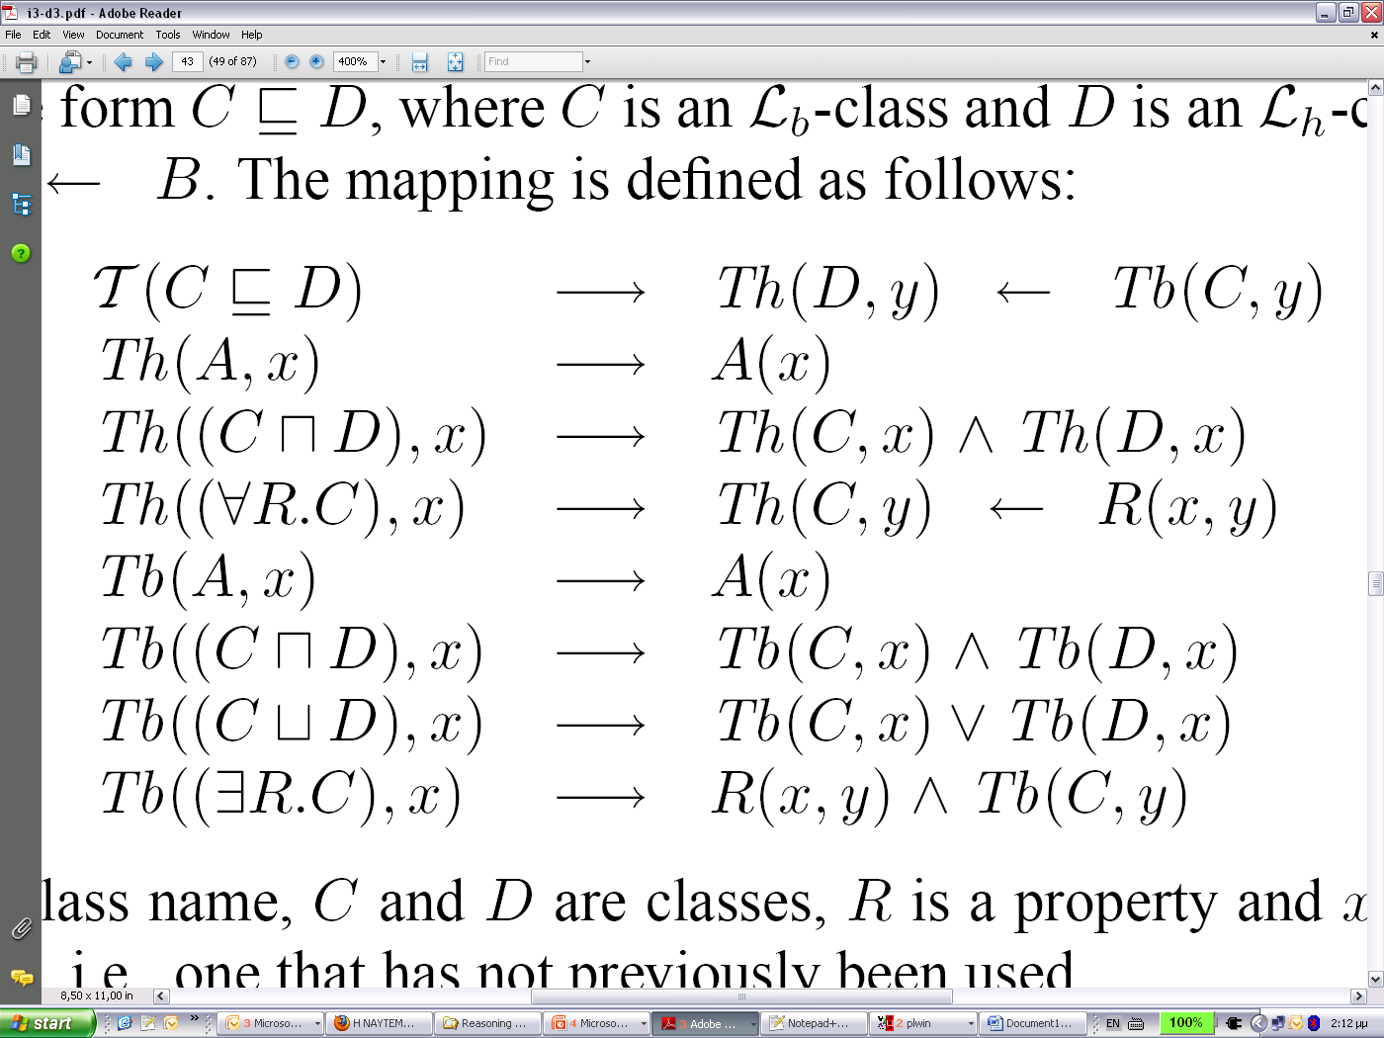
Description Logic Programs
Model - Store
Parse – Serialize
(Input - Output)
Query
Manipulate
Reason (Inference)
Grossof and Horrocs, define mapping rules between DL and LP
Example An ontology which contains the axioms:
subClassOf(cat, mammal).
classAssertion(cat, mr_whiskers).
inverseProperties(likes,liked_by).
will be converted to a program such as:
mammal(X) :- cat(X).
cat(mr_whiskers).
likes(X,Y) :- liked_by(Y,X).
liked_by(X,Y) :- likes(Y,X).
Notes:
Monotonicity
p :- q, not (t)
q.
p.
Adding t, invalidates p.

Slide 20
Thea RL rule reasoning
Model - Store
Parse – Serialize
(Input - Output)
Query
Manipulate
Reason (Inference)
RL Profile, RL/RDF rules:
Scalable reasoning, trade full expressivity of the language for efficiency.
Syntactic subset of OWL 2 which is amenable to implementation using rule-based technologies
partial axiomatization of the OWL 2 RDF-Based Semantics in the form of first-order implications
inspired by Description Logic Programs
Implementation
Declarative rule definition (entailments): entails(Rule, AntecedentList, ConsequenttList)
entails(prp-dom, [propertyDomain(P,C),propertyAssertion(P,X,_)],[classAssertion(C,X)]).
entails(prp-rng, [propertyRange(P,C),propertyAssertion(P,_,Y)],[classAssertion(C,Y)]).
Forward Chaining, Crude non-optimized, Repeat cycle until nothing has been entailed
forall((entails(Rule,Antecedants,Consequents),
hold(Antecedants),member(Consequent,Consequents)),
assert_u(entailed(Consequent,Rule,Antecedants)).
Backward Chaining
%% is_entailed(+Axiom,-Explanation) is nondet
% Axiom is entailed if either holds or is a consequent in an
% entails/3 rule and all the antecedants are entailed.
Simulates tabling: If an Axiom has been entailed it is not tried again to revents endless loops for e.g. s :- s, t.
Notes:
Monotonicity
p :- q, not (t)
q.
p.
Adding t, invalidates p.

Slide 21
SWRL implementation
Model - Store
Parse – Serialize
(Input - Output)
Query
Manipulate
Reason (Inference)
Semantic Web Rules.
To extend the set of OWL axioms to include Horn-like rules. It thus enables Horn-like rules to be combined with an OWL knowledge base. From (SWRL submission spec)
Thea implementation
Implies/2 fact to hold rules: implies(?Antecedent:list(swrlAtom), ?Consequent:list(swrlAtom))
Convert a prolog clause to SWRL rule
Convert an SWRL rule to OWL axioms
?- prolog_clause_to_swrl_rule((hasUncle(X1,X3):-
hasParent(X1,X2),hasBrother(X2,X3)),SWRL),
swrl_to_owl_axioms(SWRL,Axiom).
X1 = v(1), X3 = v(2), X2 = v(3),
SWRL = implies(['_d:hasParent'(v(1), v(3)), '_d:hasBrother'(v(3), v(2))], '_d:hasUncle'(v(1), v(2))),
Axiom = [subPropertyOf(propertyChain(['_d:hasParent', '_d:hasBrother']), '_d:hasUncle')].
Notes:
Monotonicity
p :- q, not (t)
q.
p.
Adding t, invalidates p.

Slide 22
Comparison with other systems
SPARQL
No means of updating data
Too RDF-centric for querying complex Tboxes
Lack of ability to name queries (as in relational views)
Lack of aggregate queries
Lack of programmability
But … extensions (SPARQL update)
OPPL (DSL):
Simple, SQL – like
In Protégé…
Thea offers a complete programming language.

Slide 23
Comparison with OWLAPI
OWLAPI:
Full featured.
Mature.
Java API (OO language)
Thea:
declarative.
offers bridge via JPL.
easy scripting
Memory
usage
Load time
(secs)

Slide 24
Applications
OBO label generation (Bioinformatics)
eLevator (Product configuration)
Open Calais (Semantic Web)
Linked data (Semantic Web)

Slide 25

eLevator
Customer Portal
Customer eServices
Financial data
Order status
Order e-guide
Customers
Enterprise
System
PLM, CRM, ERP
Accounting…
Order Entry
Elevator Cabin
configuration
Consumers
Modeling and
Visualization
Enterprise
Internet
ASP / SaaS
Configuration
Engine Service
Notes:
Innovation Pole – Central Macedonia
Gnomon – ITI – Kleemann

Slide 26
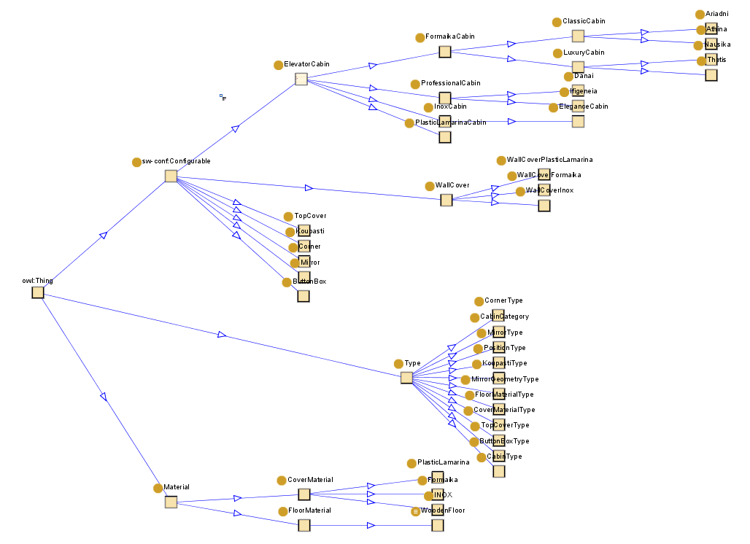
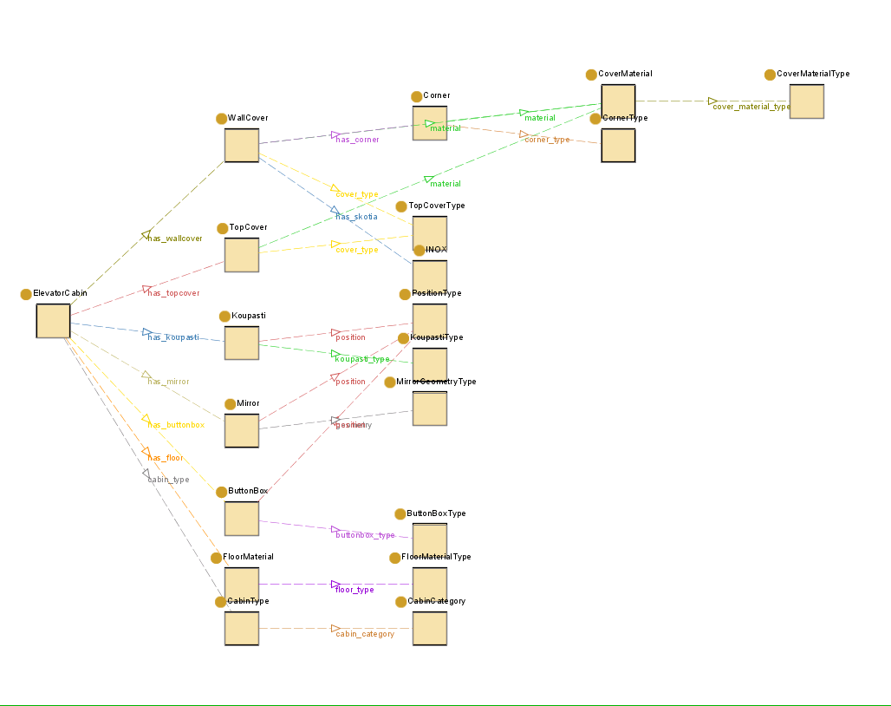
Configuration Ontology
Partonomy
Taxonomy

Slide 27
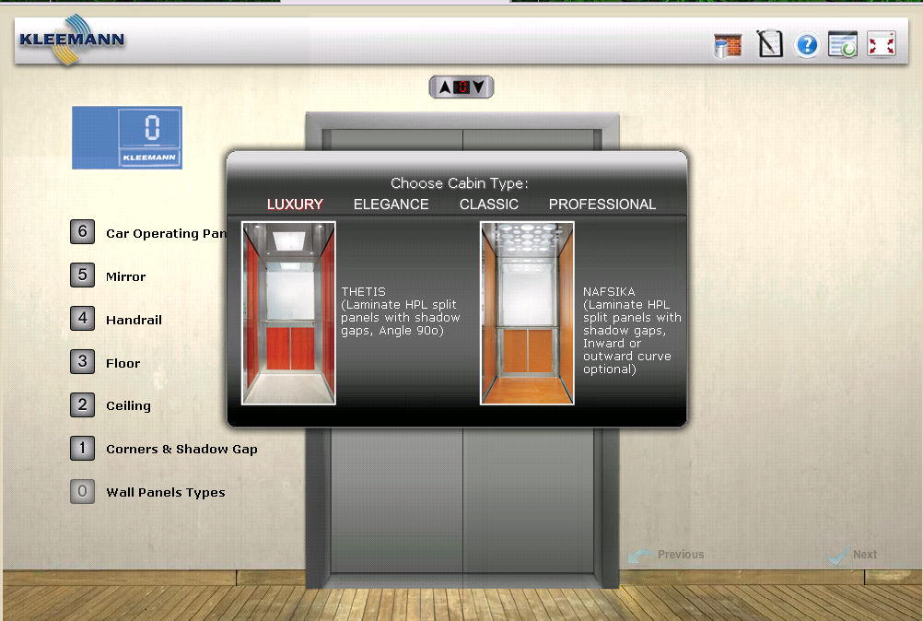
www.designyourlift.com

Slide 28
Bioinformatics label generation
Challenges in OBO: maintaining consistent class labels that conform to community norms.
OWL + Prolog Definite Clause Grammars (DCGs) to auto-generate labels or suggestions for labels. Example
OWL Class: length and qualityOf some (axon and partOf some pyramidal_neuron)
Derive label length of pyramidal neuron axon.
DCG
term(T) --> qual_expr(T) ; anat_expr(T).
qual_expr(Q and qualityOf some A) --> qual(Q),[of],anat_expr(A).
anat_expr(P and partOf some W) --> anat(W),anat_expr(P).
anat_expr(A) --> anat(A).
anat(A) --> {entailed(subClassOf(A,anatomical_entity)),
labelAnnotation_value(A,Label)}, [Label].
qual(Q) --> {entailed(subClassOf(Q,quality)),
labelAnnotation_value(Q,Label)}, [Label].
Non-determinisim of prolog to generate multiple values.
Useful for automatically generating labels to be indexed for text search.
The same grammars used to parse controlled natural language expressions.
Notes:
Daniel Schober, Barry Smith, Suzanna Lewis, Waclaw Kusnierczyk, Jane Lomax,
Chris Mungall, Chris Taylor, Philippe Rocca-Serra, and Susanna-Assunta Sansone.
Survey-based naming conventions for use in obo foundry ontology development.
BMC Bioinformatics, 10(1):125, 2009.
Christopher J. Mungall. Obol: Integrating language and meaning in bio-ontologies.
Comparative and Functional Genomics, 5(7):509–520, 2004.

Slide 29
Open Calais
Web Service by Thomson Reuters.
Analyses content (from URLs, or POSTed text) using NLP and semantic techniques
REST interface.
Prolog Thea wrapper
Access service from within Prolog
Access and process Calais ontology (Tbox) and returned entities (Abox) with Thea
Thea
Open Calais client
Open Calais
Service
Load and Parse Ontology (OWL file)
Post Content (File, text or URL)
RDF response
Markup Elements
(Entities, Relationships) and Metadata
Notes:
Open Calais is a Web service provided by Thomson Reuters. Open Calais analyses content using NLP and semantic tecnniques and returns an RDF based response containing entities and relationships identified in the source and associated metadata.
thea_opencalais is a Prolog wrapper for accessing Open Calais and process the results. It is an application of Thea prolog library for OWL2 Ontologies. thea_opencalais uses the OpenCalais ontology and parses the service response first into Ontology axioms and finally into prolog terms and predicates, accessible from within a prolog program.

Slide 30
Open Calais example
Get your Open Calais license
Load the Open Calais Ontology into Prolog using Thea.
Post content (e.g. a URL) to the Service
Use provided Prolog predicates to examine Markup Elements (Entities and Relationships) in the result :-
oc_entity(A,B,C,E,D).
You can also write custom predicates to query the resulted database of Markup Elements e.g.
quotation(Person,Quotation) :-oc_relation(_I,'http://s.opencalais.com/1/type/em/r/Quotation',PVList), pv_attr('http://s.opencalais.com/1/pred/person',PVList,Person), pv_attr('http://s.opencalais.com/1/pred/quote',PVList,Quotation).
:- assert(thea_opencalais:open_calais(license('Your open calais license key'))).
:- owl_parse_rdf('owl.opencalais-4.3.xml.owl',[imports(false),clear(complete)]).
:oc_rest(http('http://en.wikipedia.org/wiki/List_of_journeys_of_Pope_Benedict_XVI'),'',_X).
A = 'http://d.opencalais.com/genericHasher-1/f545c2a6-ccd3-3095-adb0-c1c8dda96624', …
Notes:
Open Calais is a Web service provided by Thomson Reuters. Open Calais analyses content using NLP and semantic tecnniques and returns an RDF based response containing entities and relationships identified in the source and associated metadata.
thea_opencalais is a Prolog wrapper for accessing Open Calais and process the results. It is an application of Thea prolog library for OWL2 Ontologies. thea_opencalais uses the OpenCalais ontology and parses the service response first into Ontology axioms and finally into prolog terms and predicates, accessible from within a prolog program.

Slide 31
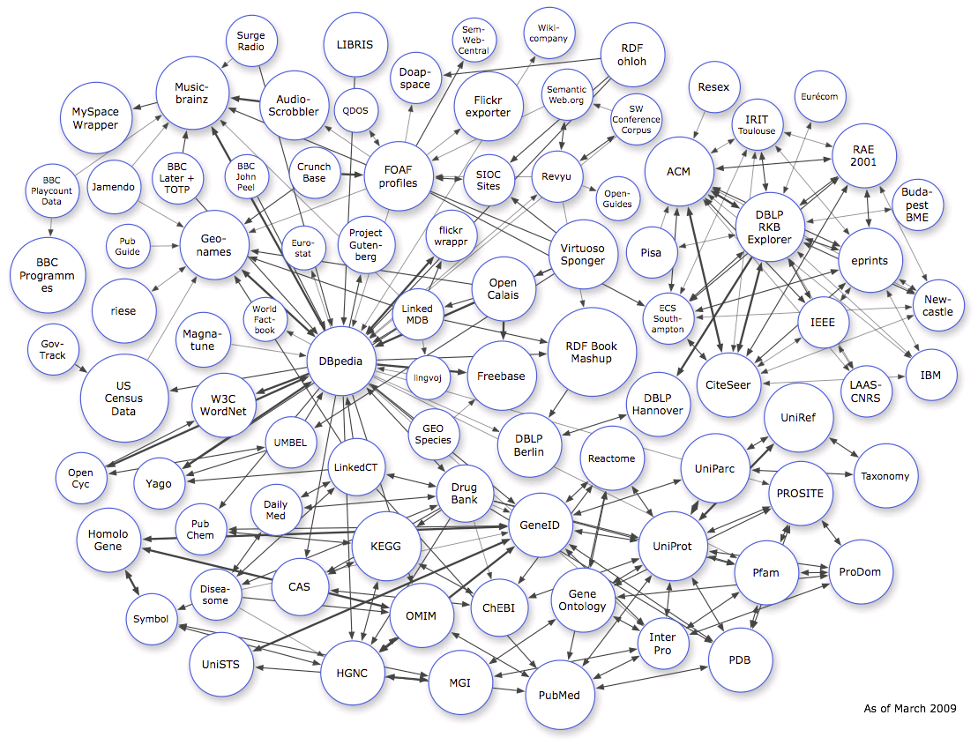
Linked data

Slide 32
Linked data
Use URIs as names for things
Use HTTP URIs so that people can look up those names.
When someone looks up a URI, provide useful information, using the standards (RDF, SPARQL)
Include links to other URIs. so that they can discover more things.

Slide 33
Conclusions Status and Next steps
OWL2 support within Prolog
Full support of OWL2 structural syntax
Easy programmatic access to query and process Ontologies within Prolog.
Import and export to different formats
Modules for external reasoning support
Next Steps
Improvements in efficiency
Complete modules (other I/Os, Reasoners etc)
Complete documentation
Portability (other Prolog systems)
Use and feedback from the community…
Applications

Slide 34
more about Thea
github.com/vangelisv/thea
www.semanticweb.gr/thea

